Slide 1






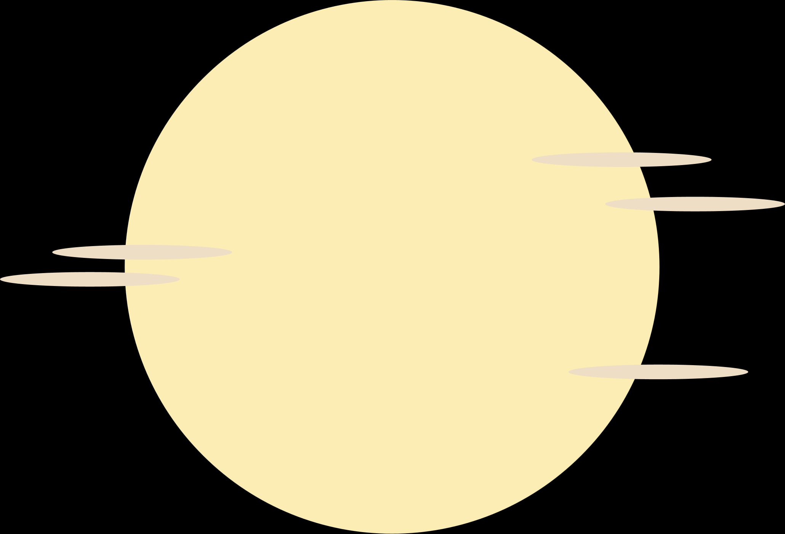










Finantasy
An OOP-Based 2D RPG Game Project

Slide 2





MEMBERS
TRAN QUOC ANH
ITITIU22006
PHAN TRAN THANH HUY
ITCSIU22056
NGUYEN DINH KHANH NGAN
ITCSIU22236

Slide 3





Table of contents
Introduction
Demo
01
02
Overview of the game project
Code, demonstration videos and instructions
Software Requirements
UI Design
03
04
Analysis of needs, tools, and use cases
Overview of game architecture and core functionalities
Experience
05
Project experience

Slide 4








01
Introduction

Slide 5




1.1 Gaming in the field
Developing a turn-based game for our "Object-Oriented Programming" course has allowed us to apply theories learned in class and enhance our Java programming skills. This project integrates various disciplines such as art, music, and programming to create a compelling game experience.
1.2 About the game project
Our game is inspired by classic turn-based strategy games like Final Fantasy I. It features modern UI enhancements, additional weapons, and monsters with unique abilities, aiming to improve user experience while paying homage to its predecessors.

Slide 6

1.3 Our game project
Drawing inspiration from Square Enix's Final Fantasy series, our game adopts the fundamental turn-based gameplay mechanics. We've enhanced the game by adjusting character abilities, improving aesthetics with new sounds and animations, and implementing advanced Object-Oriented Programming principles like factory and adapter patterns.
Github

Slide 7











02
DEMO

Slide 8
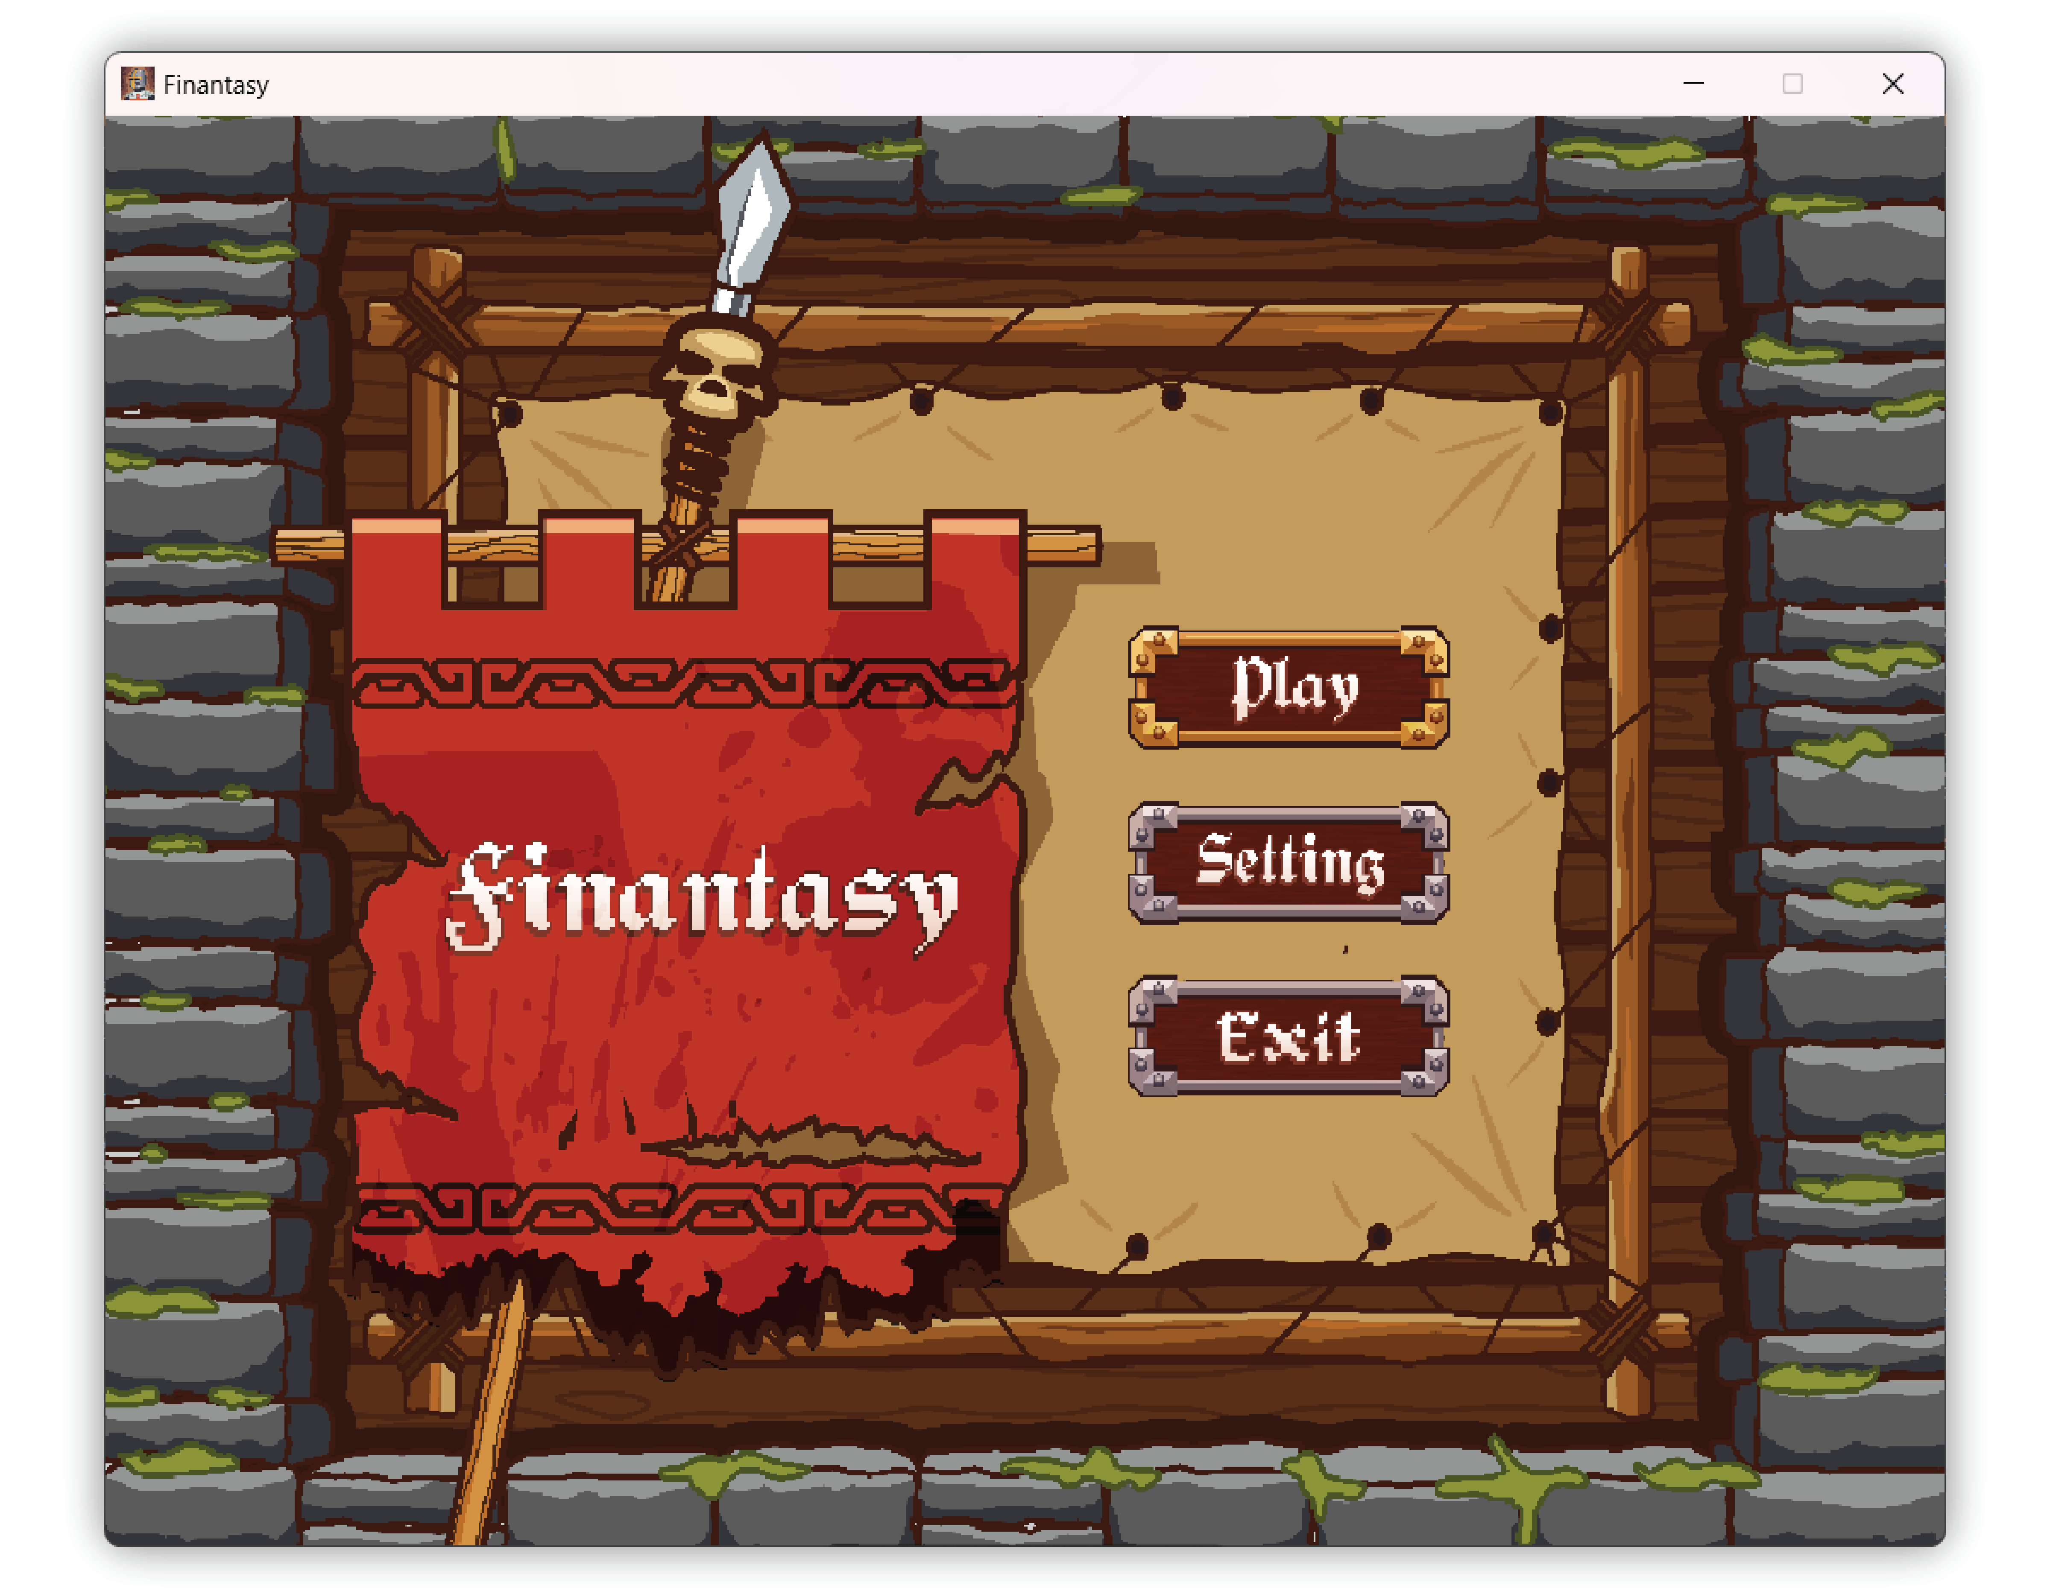
Menu screen

Slide 9
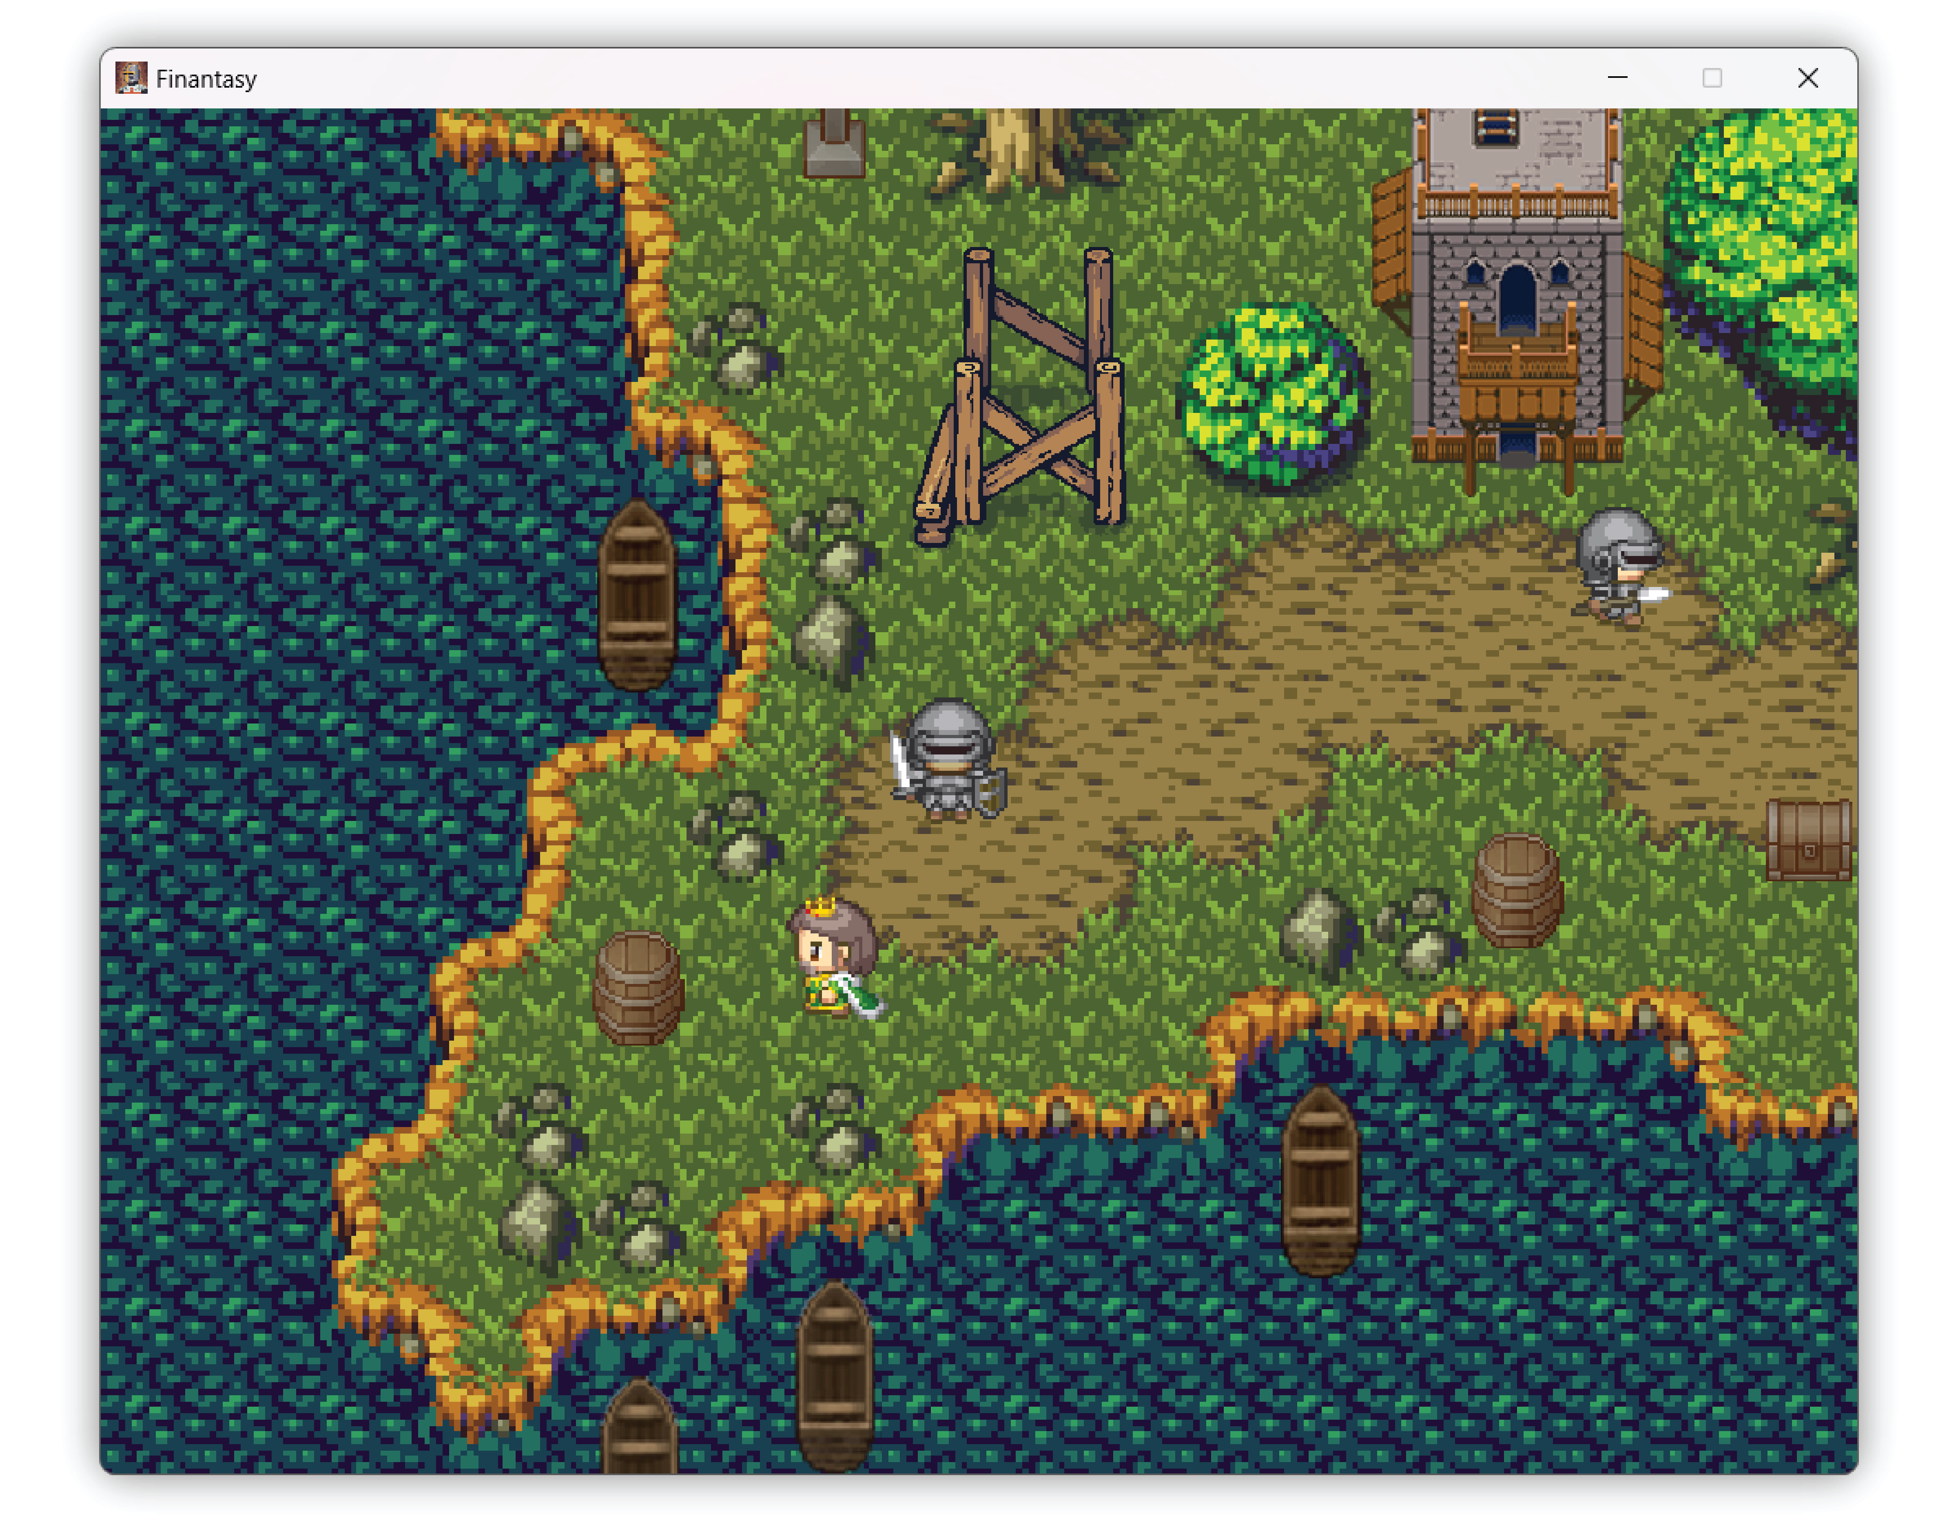
The beginning

Slide 10
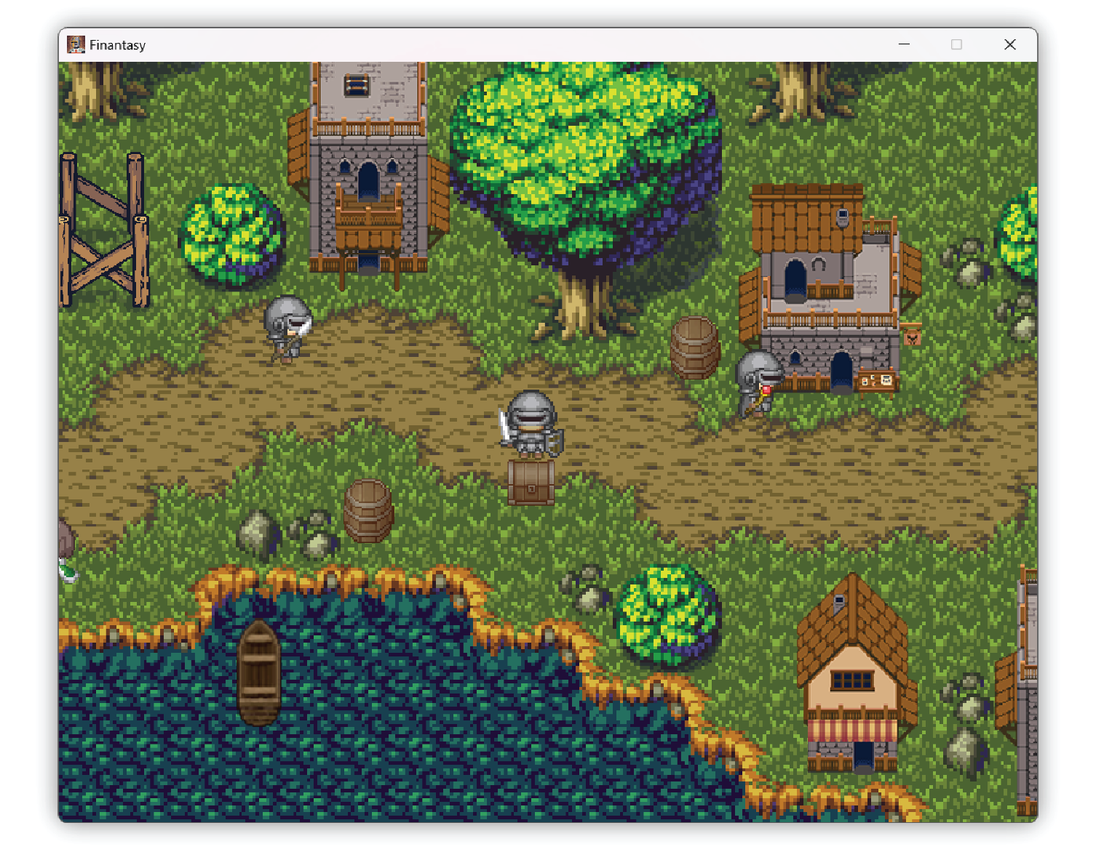
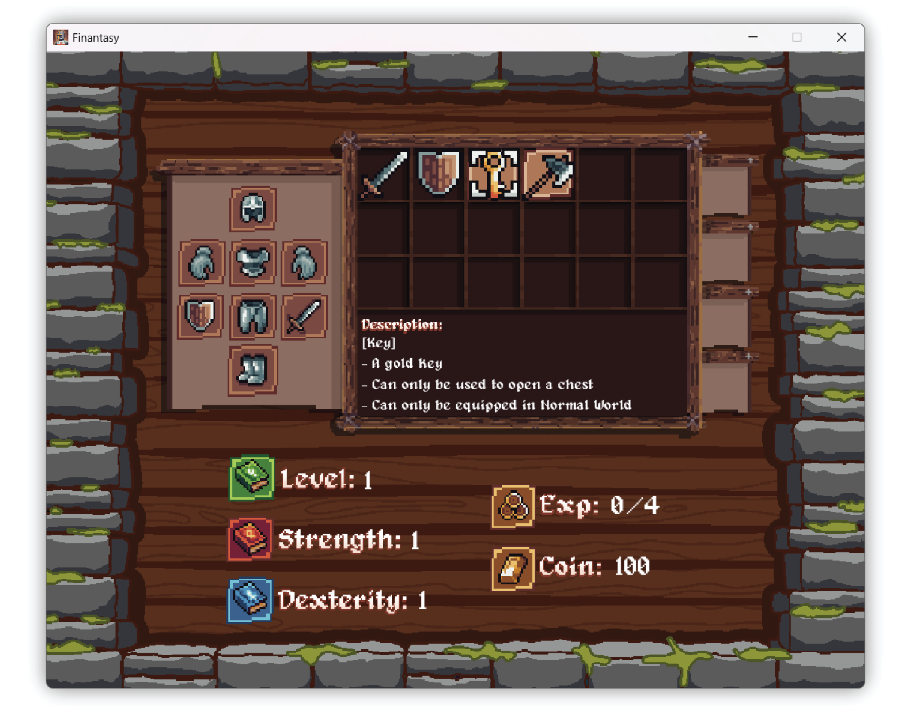
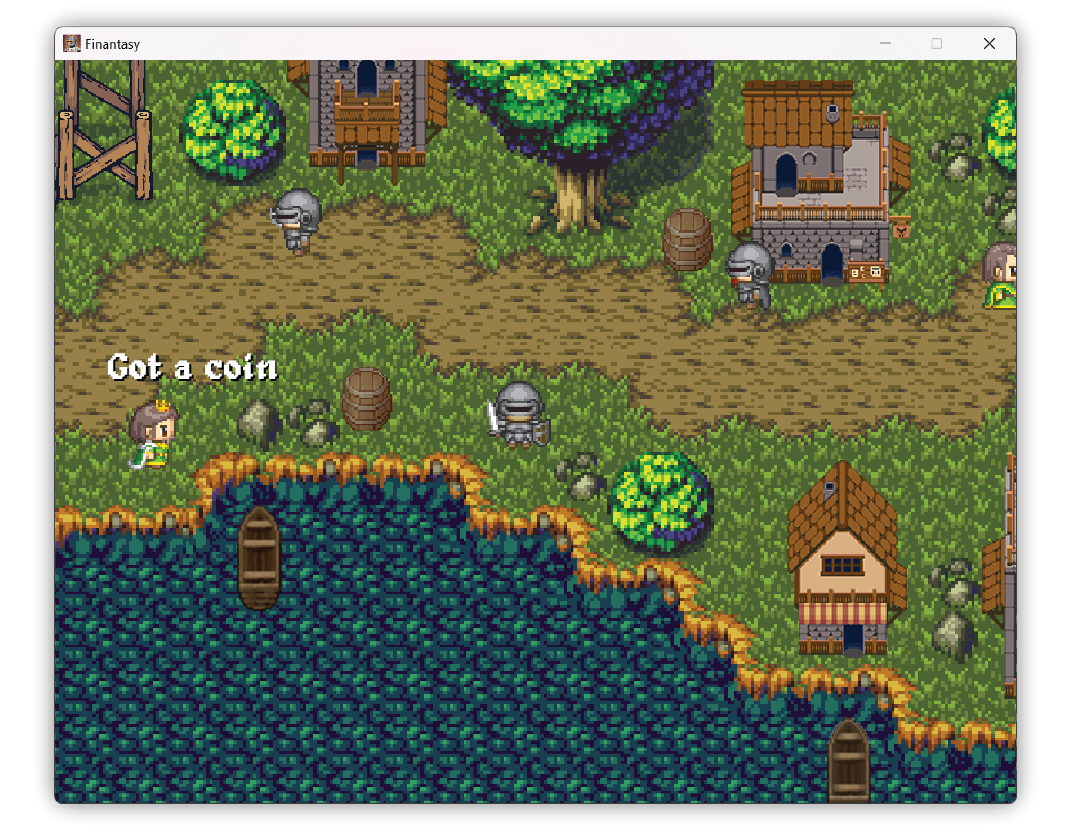
Interact with objects
Step1: hitting objects
Step2: equipping
suitable items
Step2: pressing enter
button

Slide 11
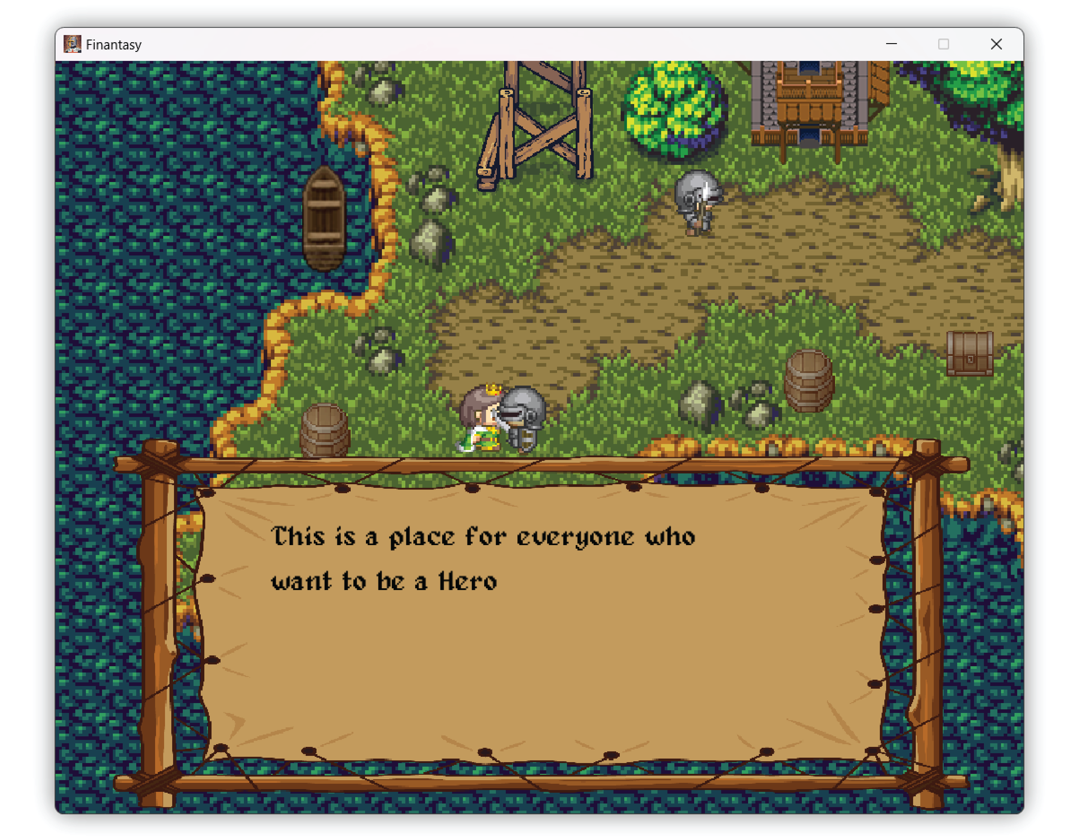
Interact with NPCs
Hitting NPCs and pressing enter button

Slide 12
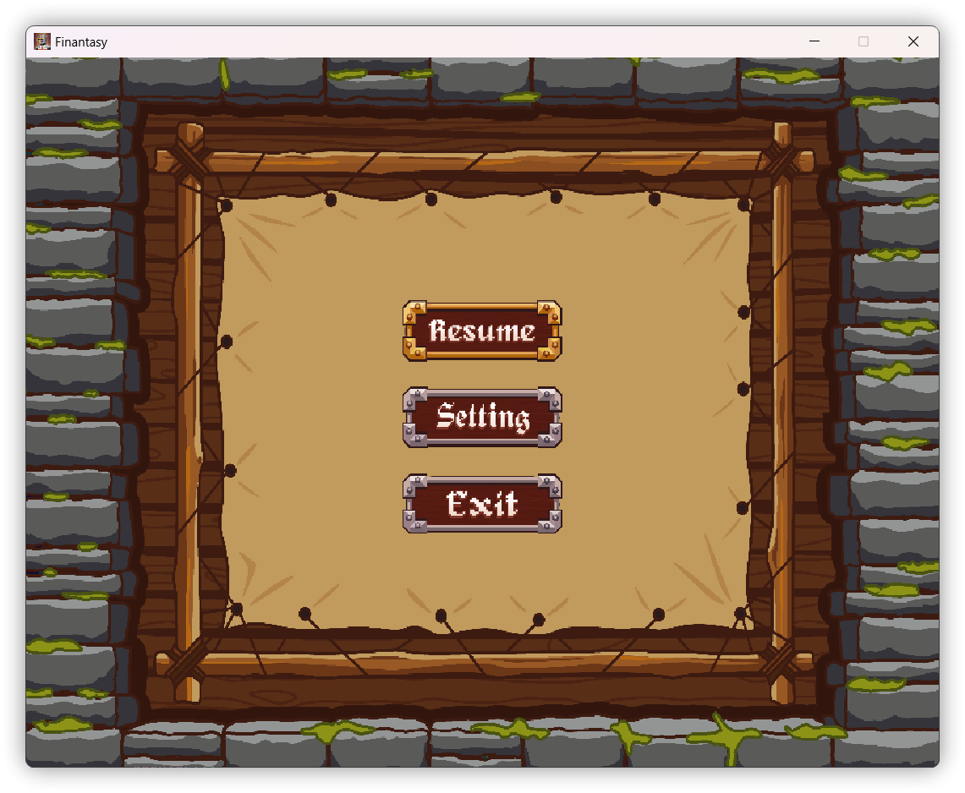
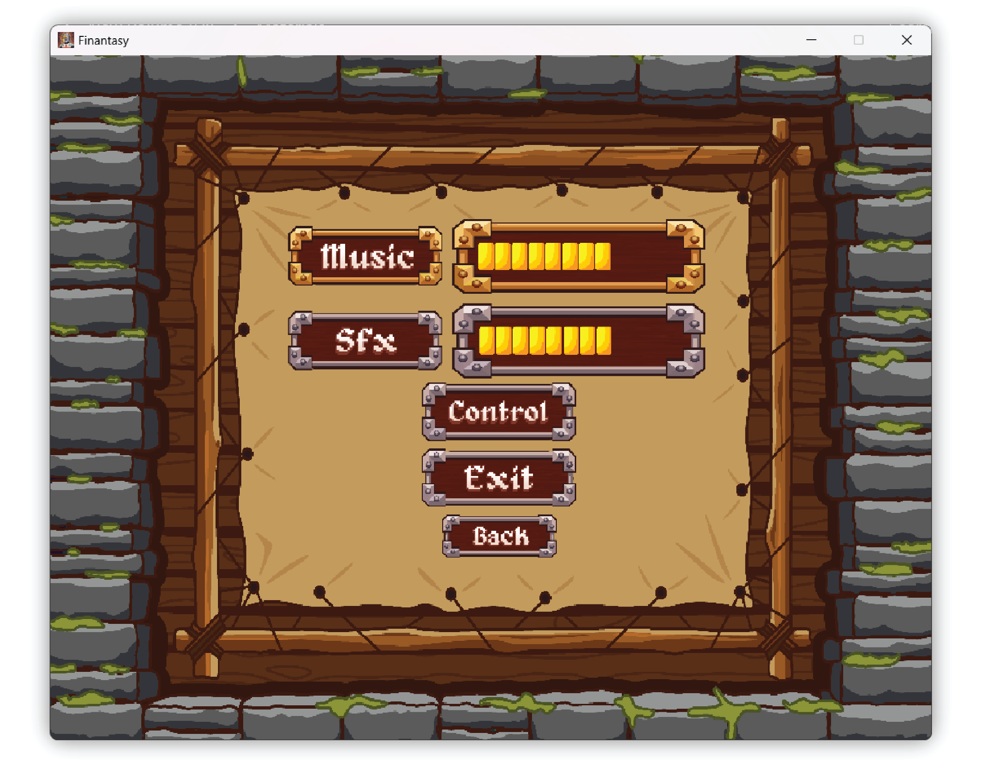
Pause Game & Settings
Pausing game Setting state

Slide 13
Interact with NPCs
Hitting NPCs and pressing enter button

Slide 14
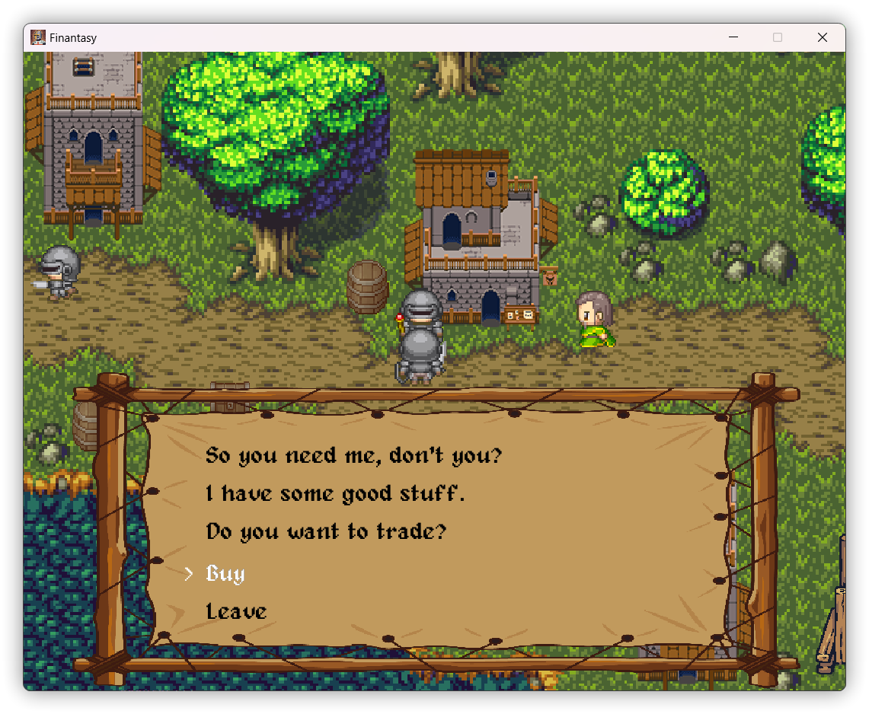
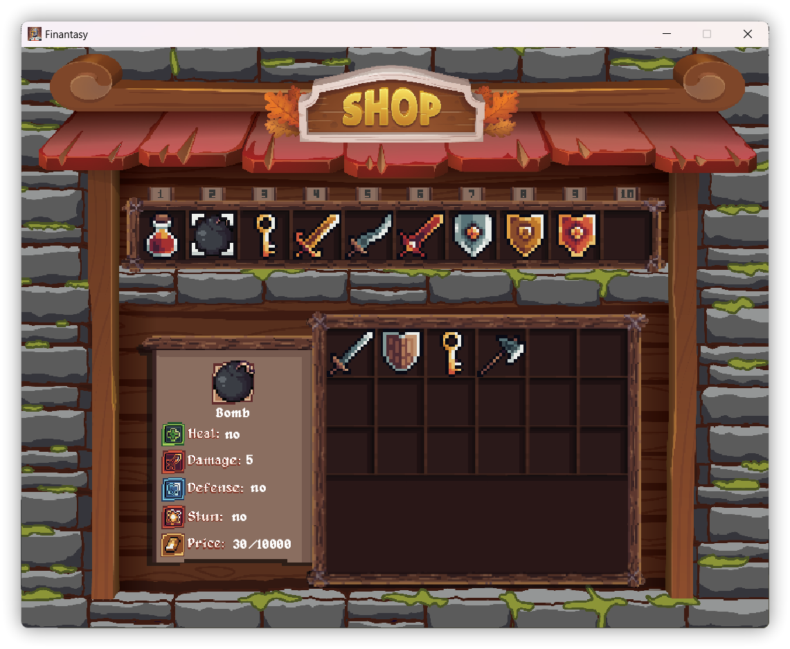
Buying - items system
Hitting Merchant NPC and pressing enter button

Slide 15
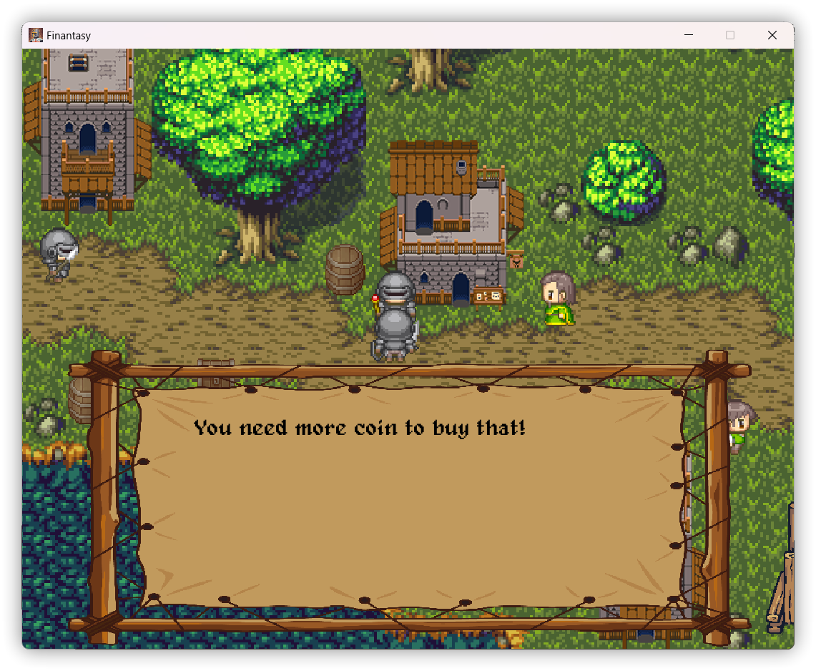
Buying - items system
You can not buy anything when you run out of money

Slide 16
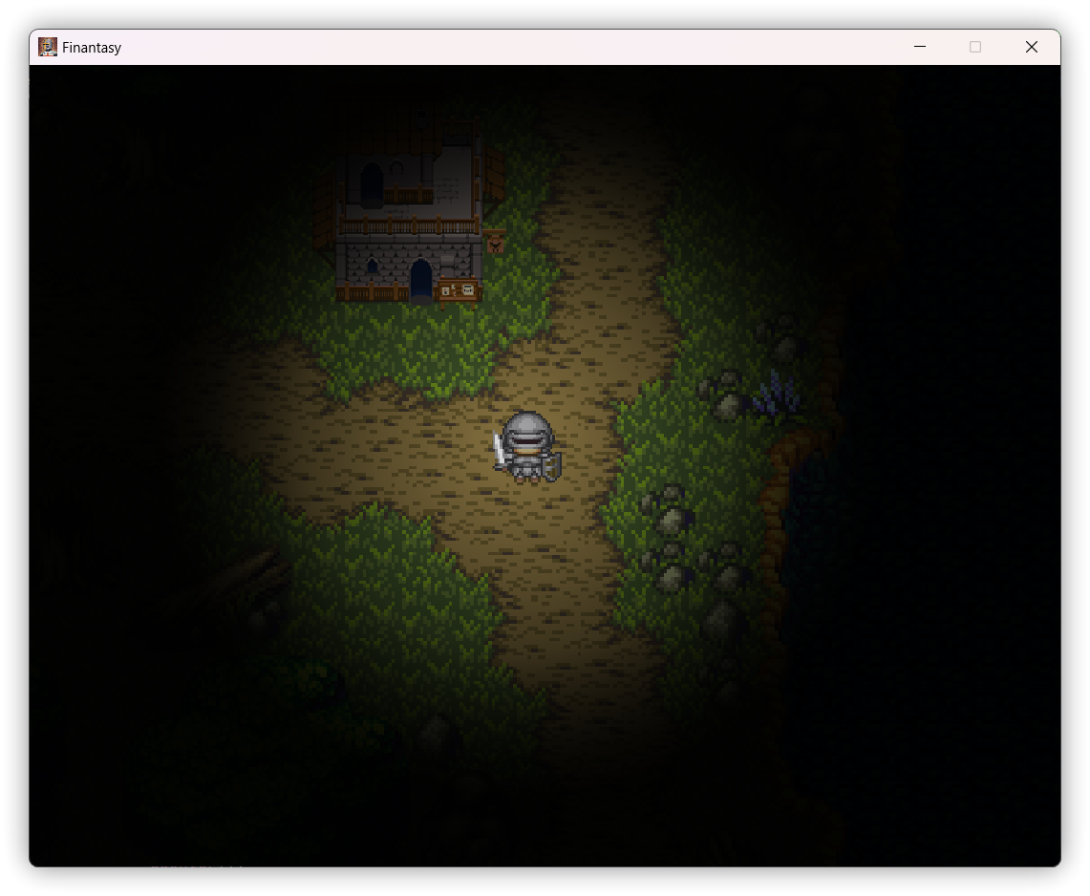
Date – and – night system
Daytime night time

Slide 17
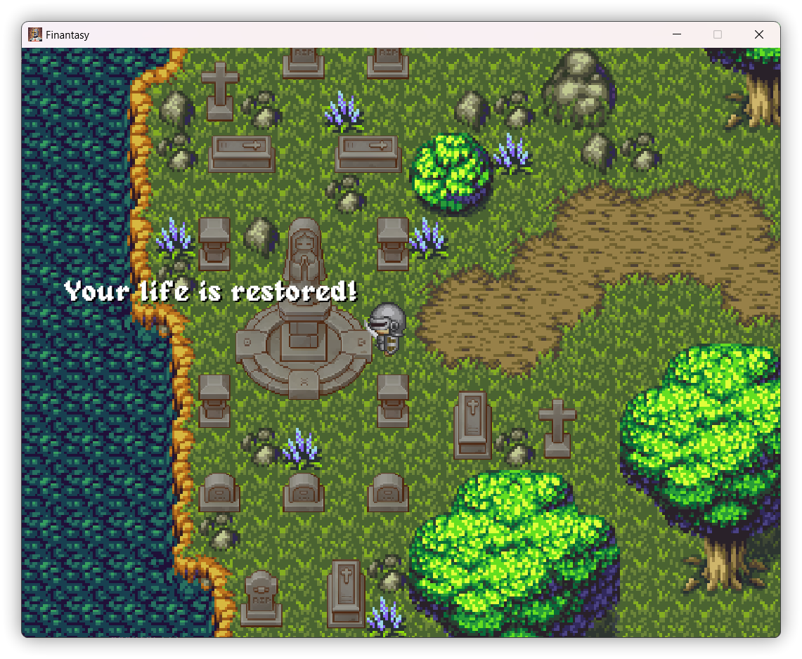
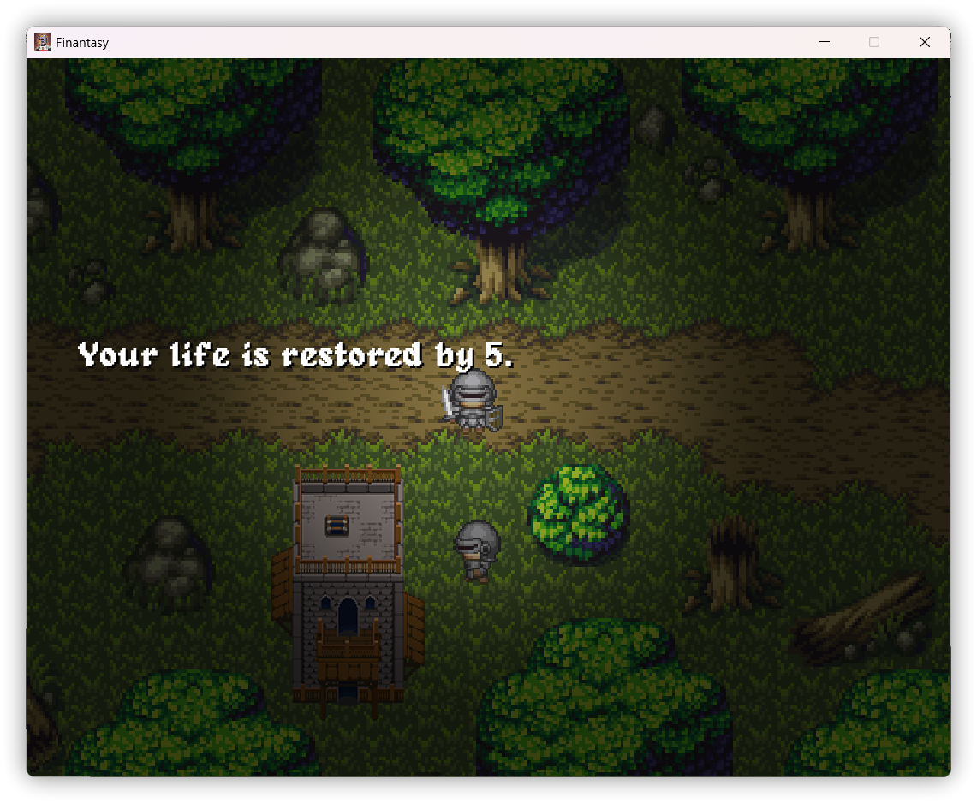
Healing systems
Healing by healing pot
Healing by holy statue

Slide 18
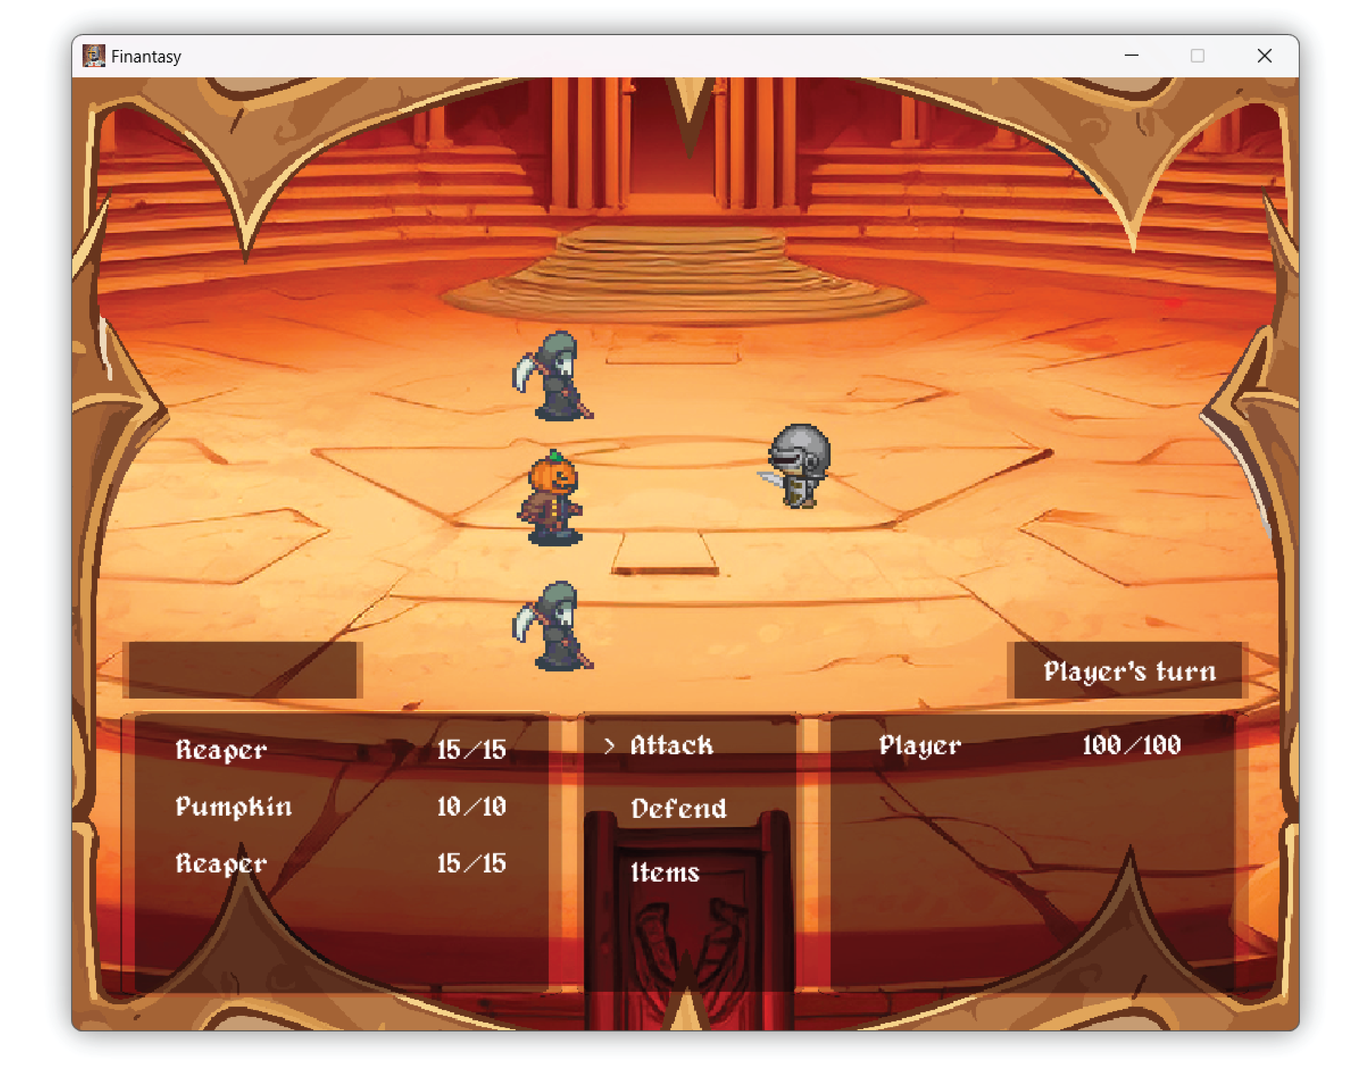
Battle system

Slide 19
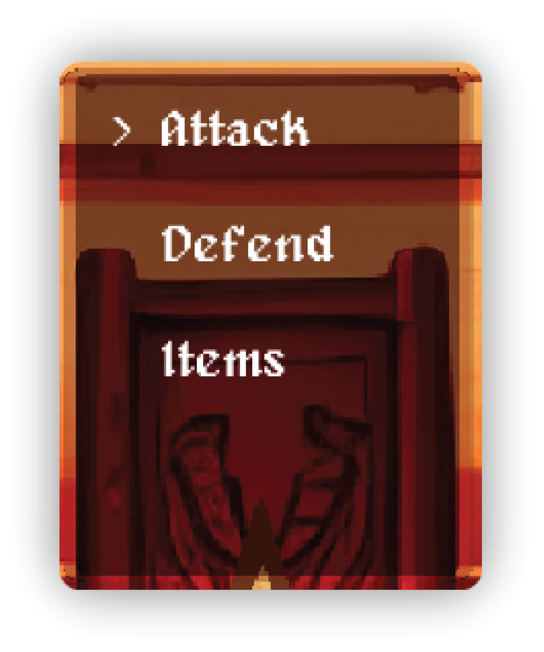
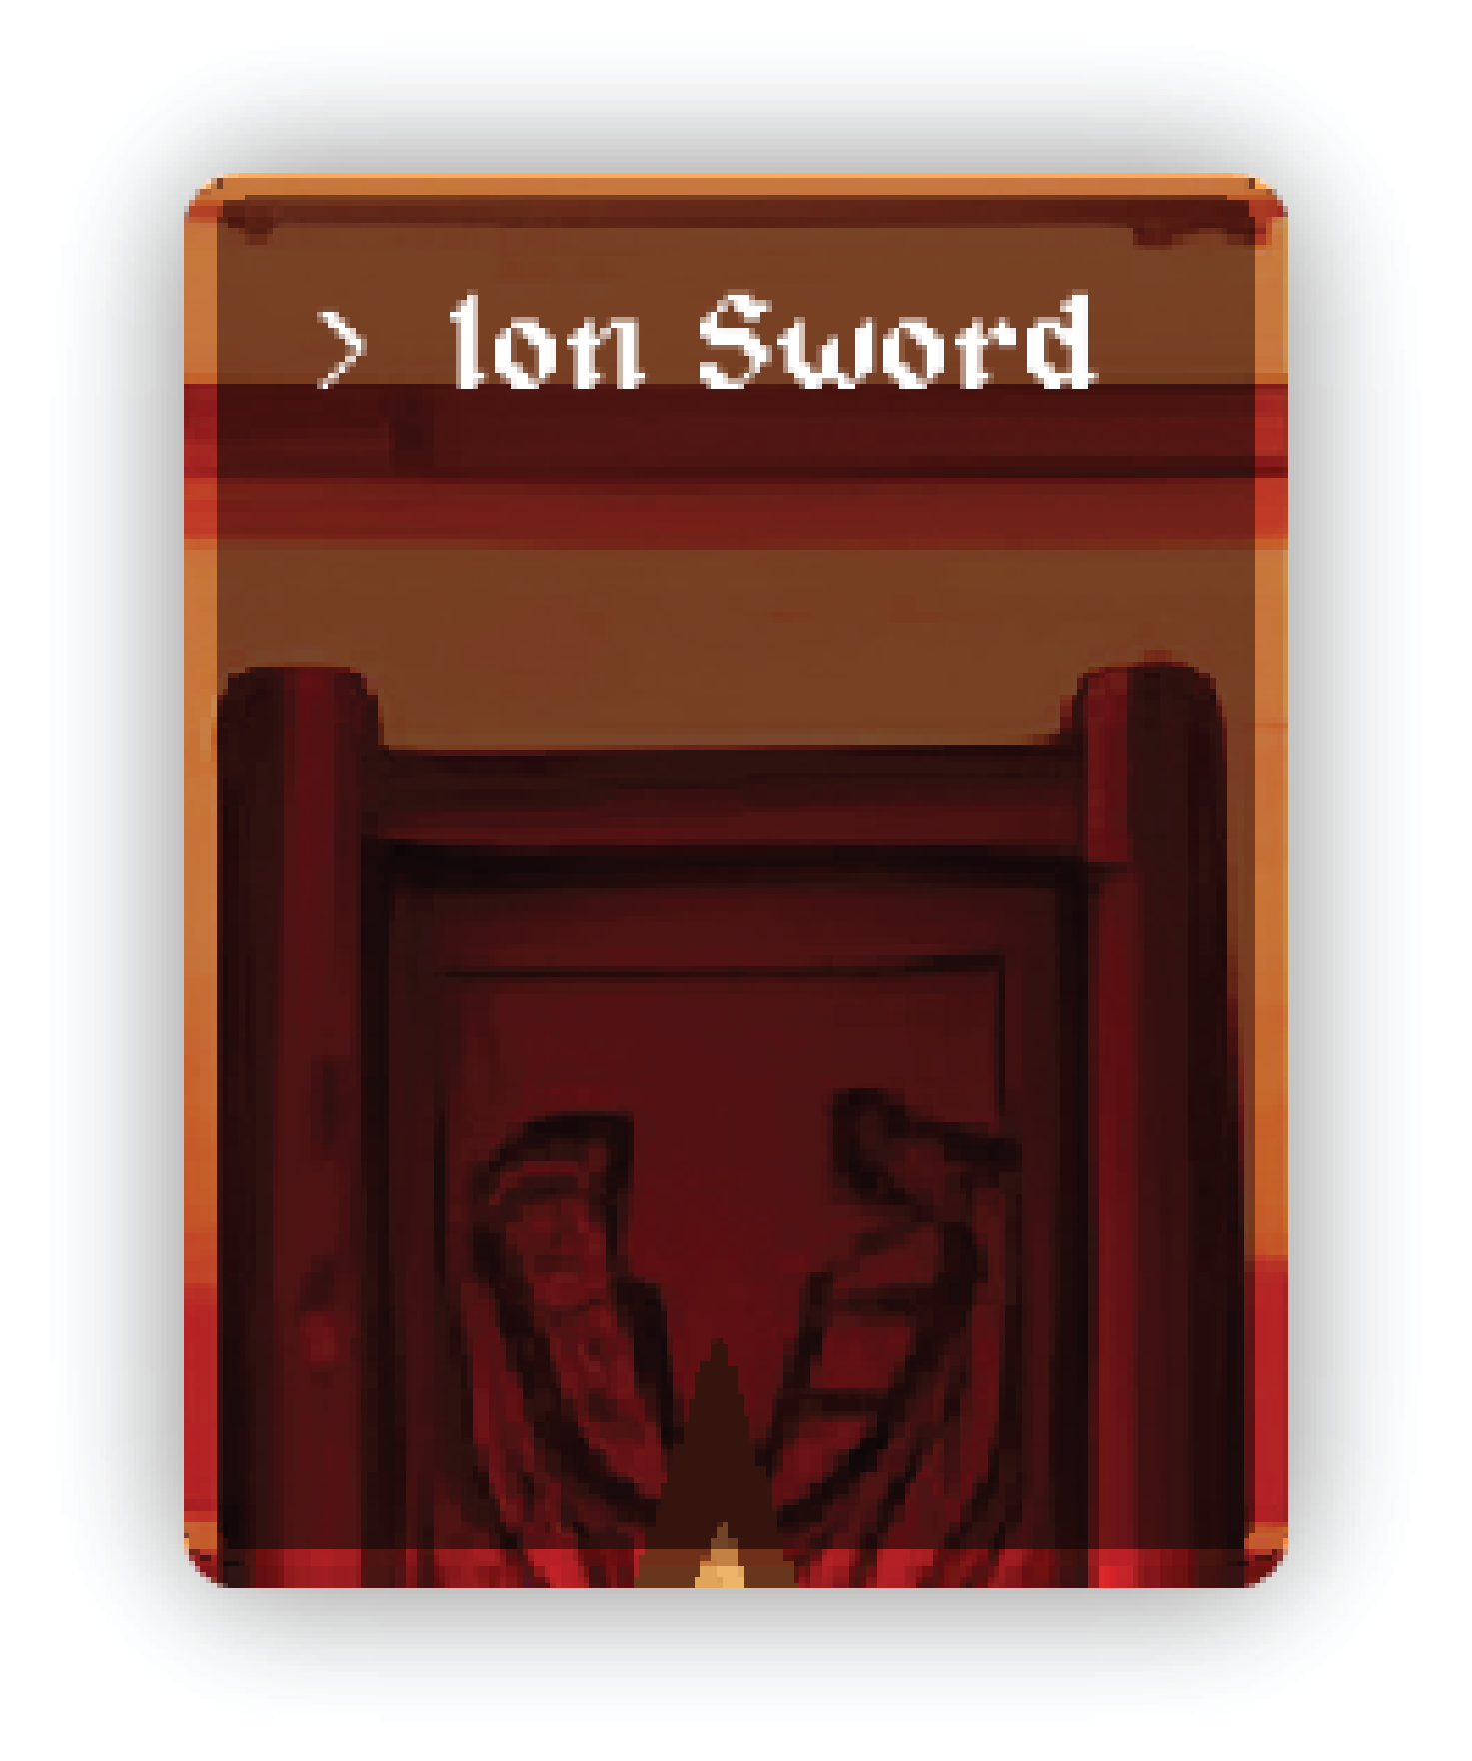
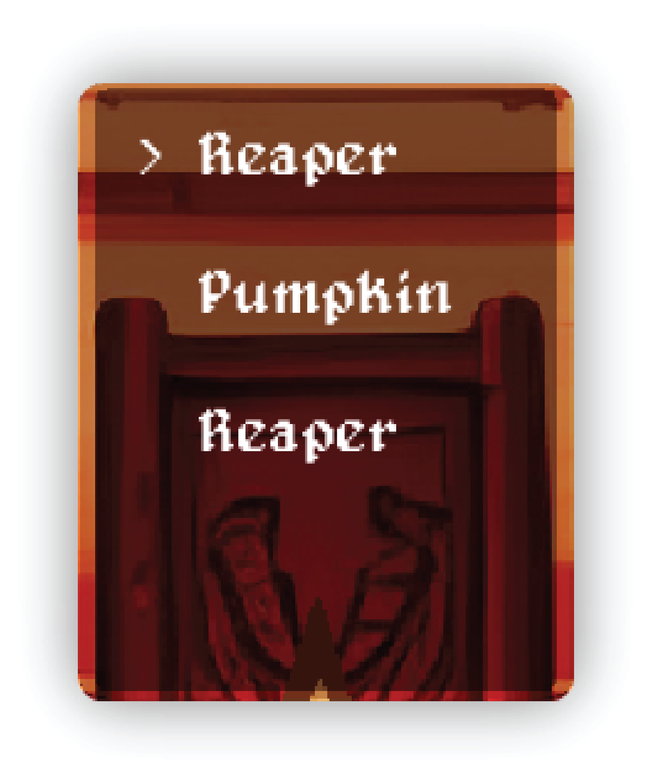
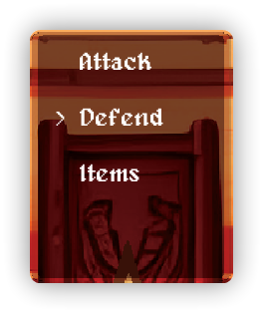
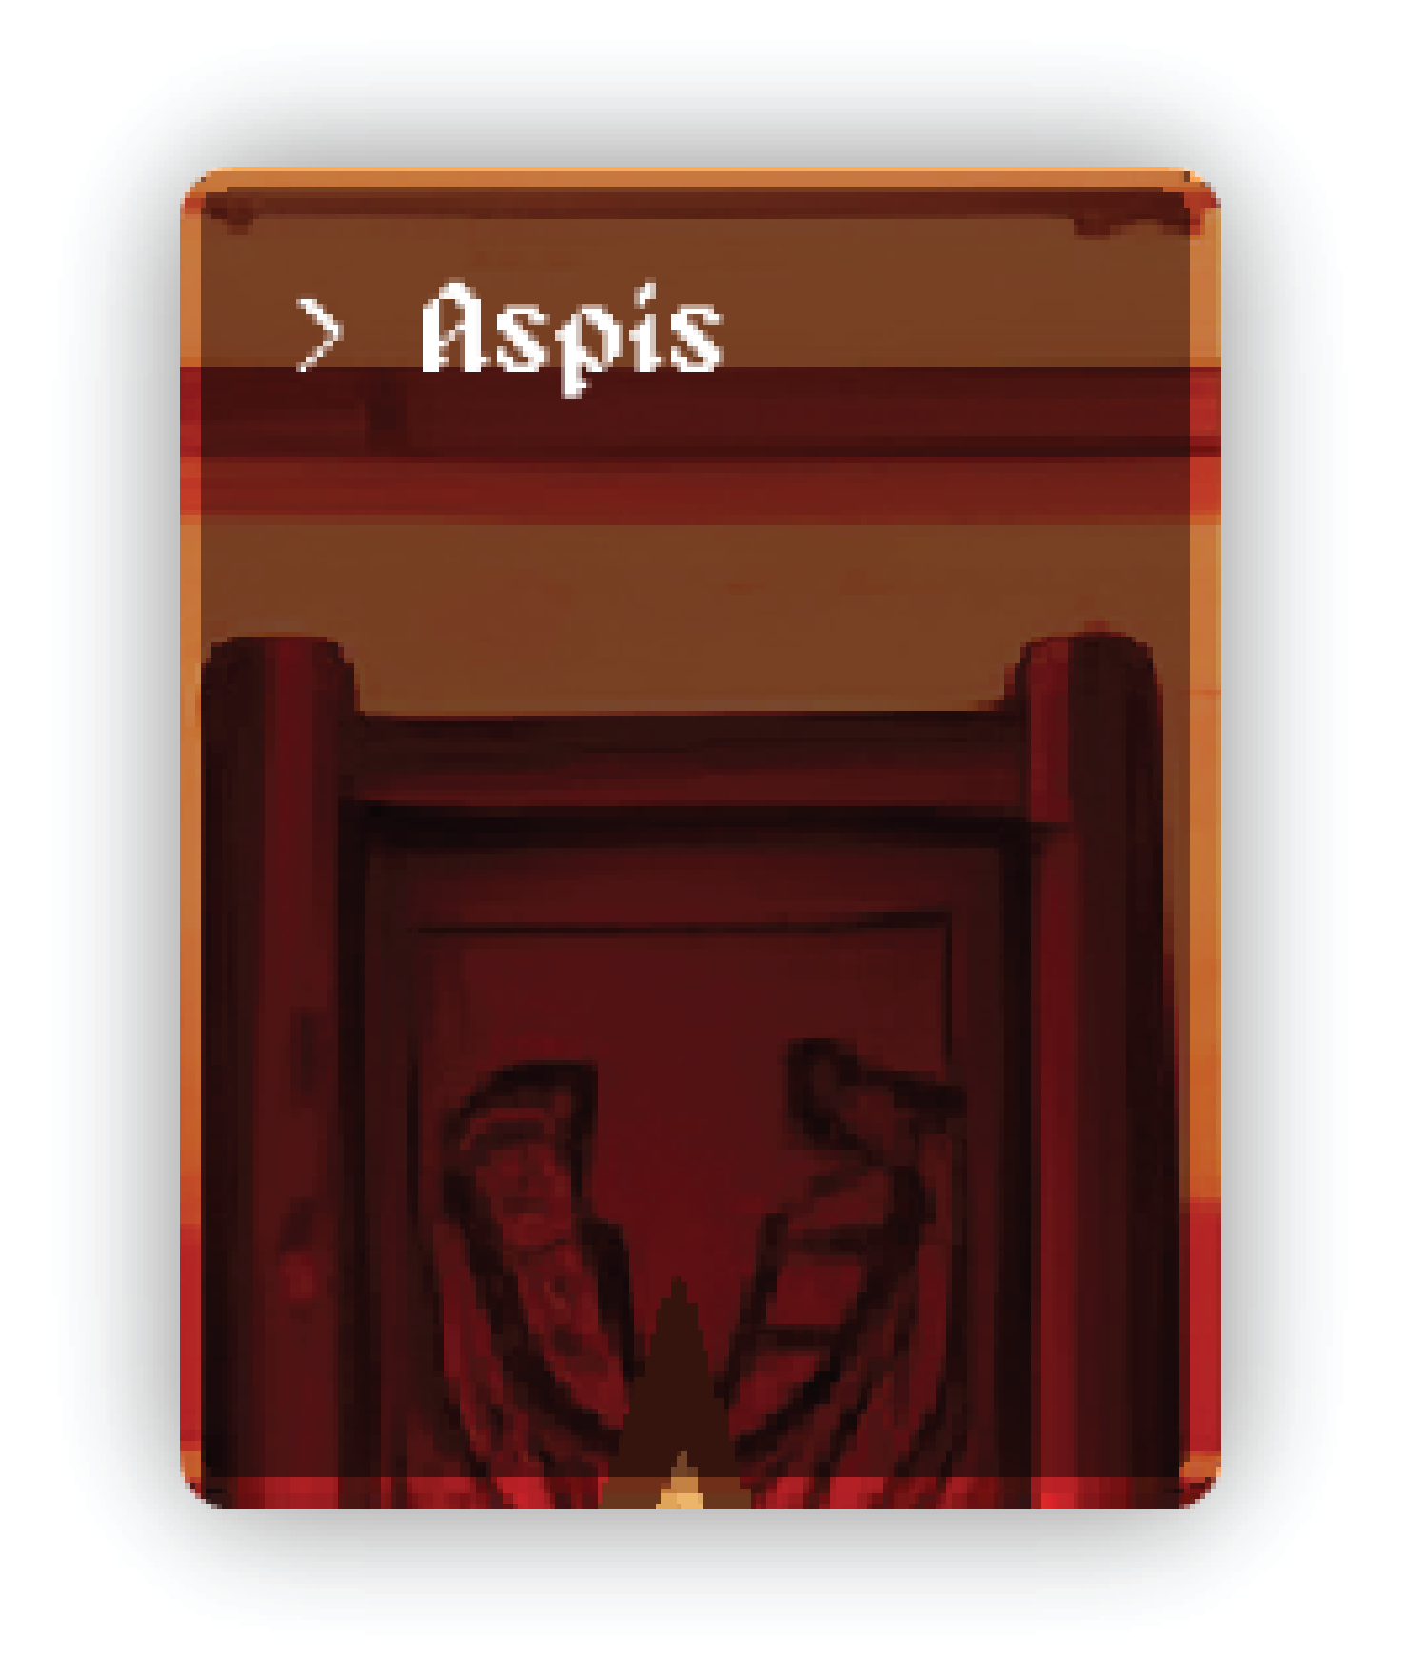
Battle system
Making
decisions
Choosing weapons
And enemies to attack
Choosing defense and
types of shields

Slide 20
03
Software
requirements

Slide 21
3.1 What we have
Our focus lies in minimizing maintenance costs for graphics while ensuring a user-friendly interface compatible with standard PC setups. Our development practices are guided by professional experience and adhere to industry-standard coding practices.
3.2 What we desire
Our goals include developing the game within a reasonable budget, enhancing visual quality with high-definition graphics, facilitating straightforward updates, and employing efficient game development methodologies.

Slide 22
3.3 Working tools and Platforms
Visual Studio Code with addition library JRE System Library [JavaSE-17] implementation ‘Eclipse Temurin JDK with Hotspot 17.0.3+7 (x64)’
IntelliJ IDEA for Java and Kotlin JRE System Library [JavaSE-17] implementation ‘Eclipse Temurin JDK with Hotspot 17.0.3+7 (x64)’
Adobe illustrator 2023
Adobe Photoshop 2023
Tiled

Slide 23
3.4 Use case scenario
FINANTASY | PLAY | Play the game
FINANTASY | PLAY | Explore the game
FINANTASY | TASKS | Do game’s side tasks
FINANTASY | TRADE | Buy the equipments
FINANTASY | FIGHT | Fight the monsters
FINANTASY | PLOT | Complete the story path

Slide 24
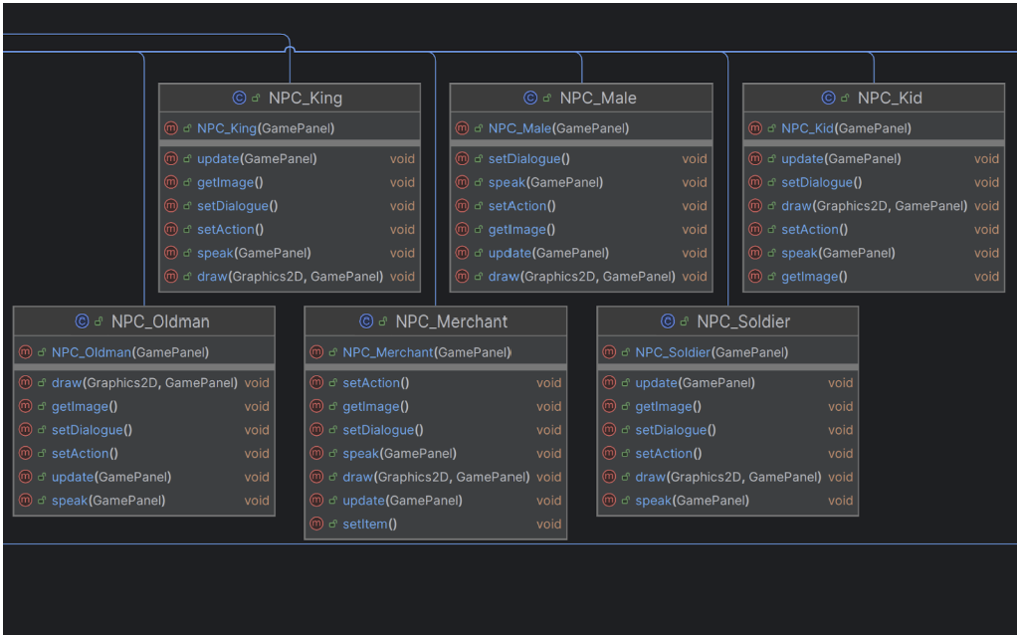
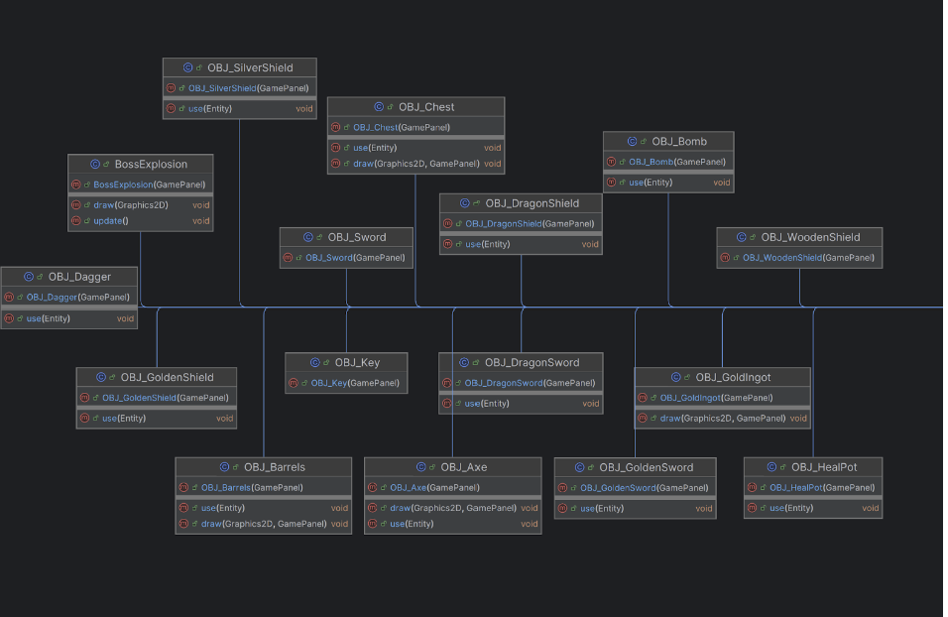
3.5 Class diagram

Slide 25
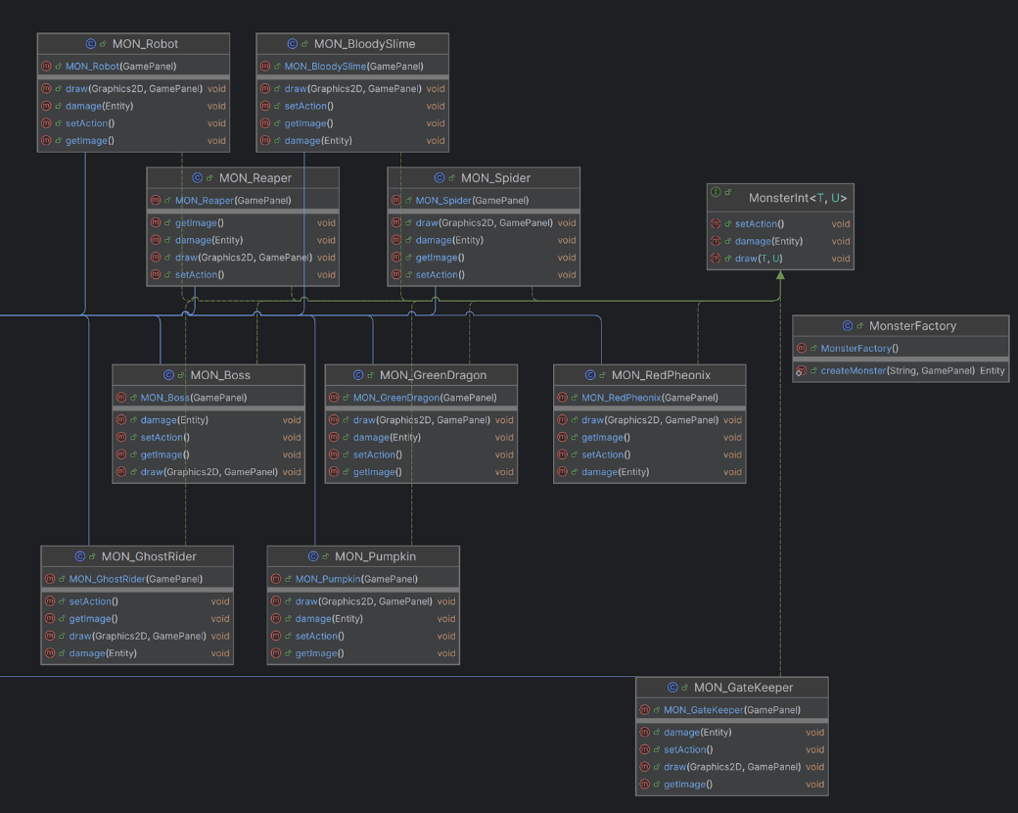
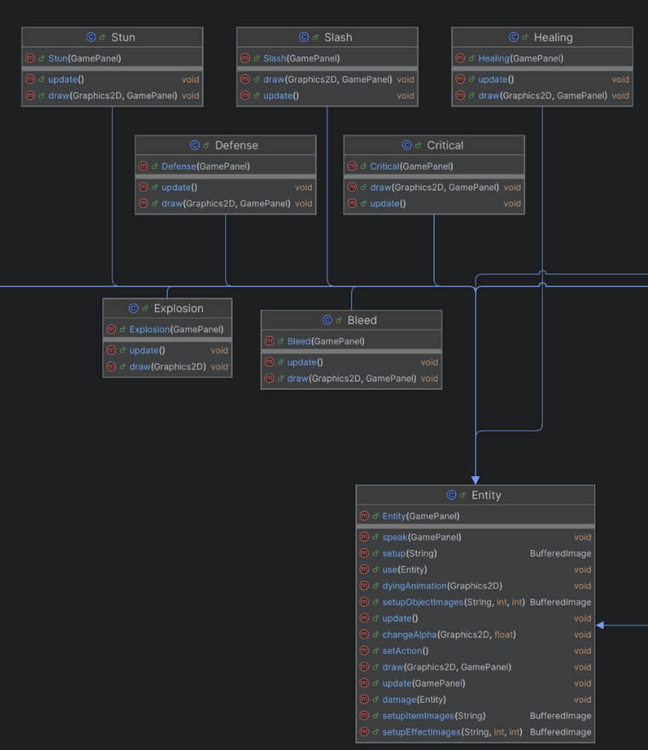
3.5 Class diagram

Slide 26
04
UI DESIGN

Slide 27
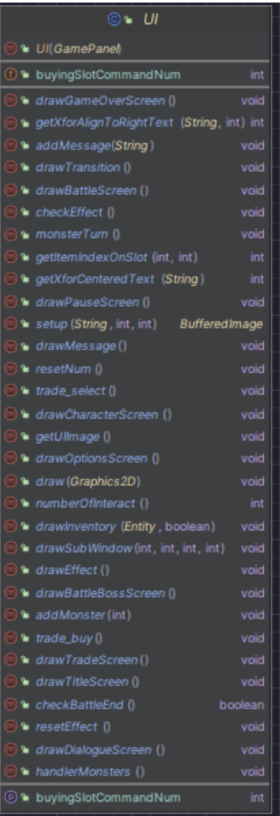
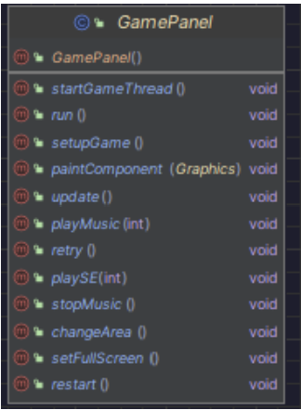
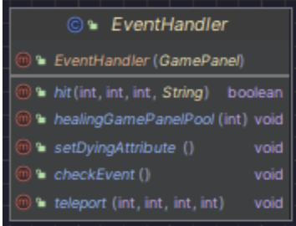
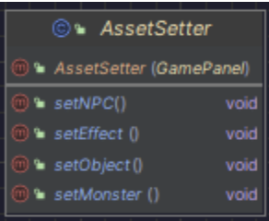

Slide 28
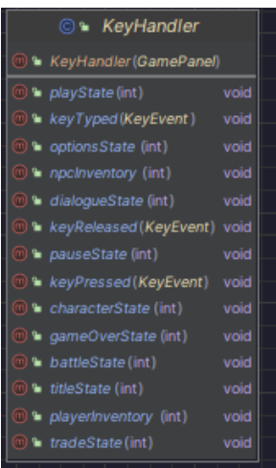
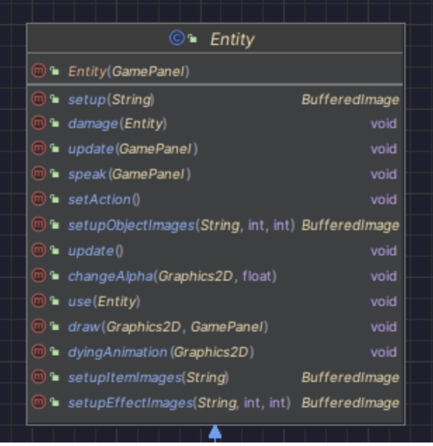
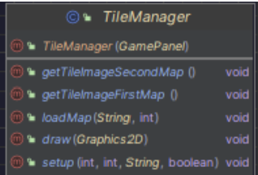
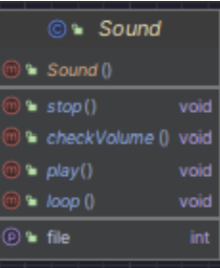
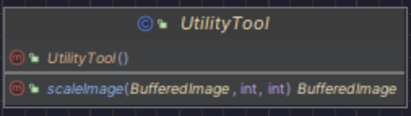

Slide 29

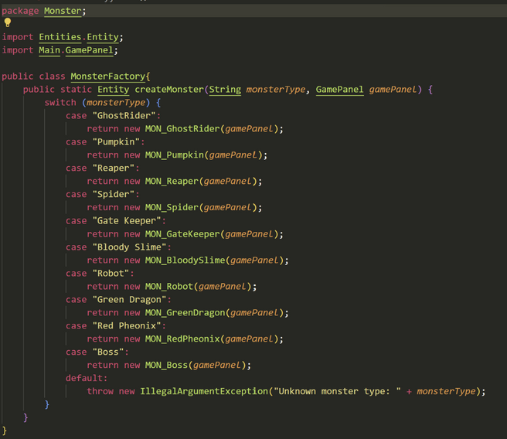
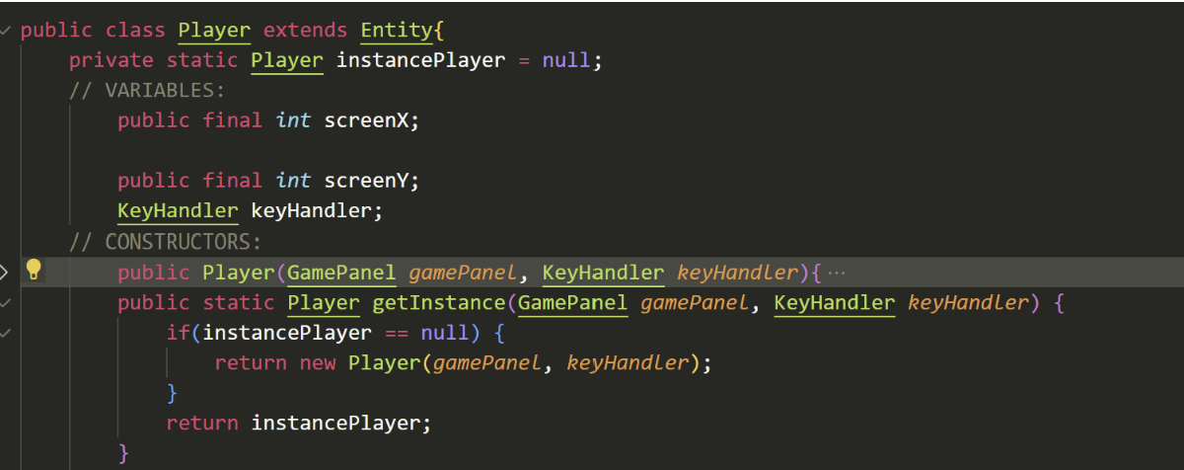




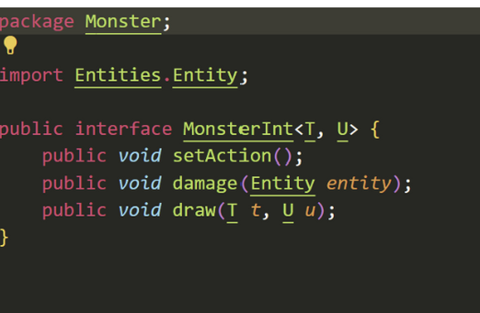
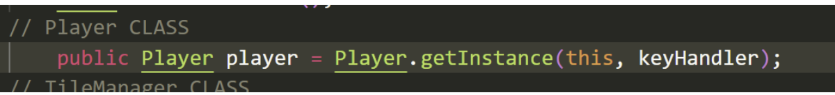
DESIGN PATTERN
Factory Design Pattern
Singleton Pattern
Concrete class
Concrete class
Instance method
Interface

Slide 30
05
EXPERIENCE

Slide 31




Game programming skills
Improve knowledge
15%
25%
35%
Opportunity practice
25%
Teamwork skills

Slide 32

References
Images from:
https://www.pinterest.com/
Top game assets - itch.io
https://stackoverflow.com/
How to make a 2D Game in Java
How to Make a 2D Game in Java
Object Oriented Programming (OOP) in Java Course
Turn-based Game idea:
Tutorial Series: Turn-Based RPG
How Do You Improve Turn-Based Combat?
Make a Turn-based RPG Combat Tutorial
More Engaging Turn-Based Combat in RPGs
Final Fantasy 1 100% walkthrough

Slide 33

Thanks
for
listening

